Slide 1
Sanskruti Shingala - AU1940124
Mansi Savaj - AU1940158
Krinal Boghani - AU1940195
Udit Kapadia - AU1940214
Stock Price Predictor
CSE523: Machine Learning
Group 8 - Team MUSK

Slide 2
Introduction
Stock market prices are characterized as non-linear, dynamic and irregular in nature.
To maximize the profit and minimize the loss, stock market prediction examines previous data and estimates future data.
Machine learning has been widely used to provide a new mechanism that can help investors to make better investments.
Machine learning does not provide an exact result, it can anticipate the value.
Obthong, Tantisantiwong, Jeamwatthanachai, & Wills. (2020, May 06). A survey on machine learning for stock price prediction: Algorithms and techniques. Retrieved April 24, 2022, from https://eprints.soton.ac.uk/437785/

Slide 3
Problem Statement
Stock Price Predictor
Develop a Predictor that best fits a model
which can predict:
1) Upcoming Trends of the Stock
2) Closing Prices for Particular stock

Slide 4
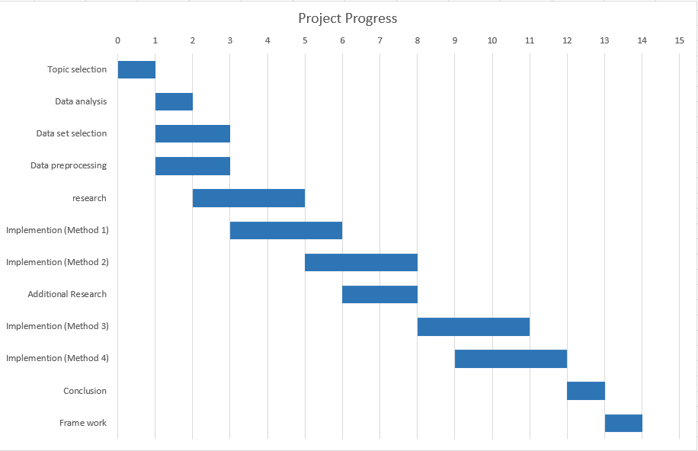
GANTT Chart showing the project progress

Slide 5
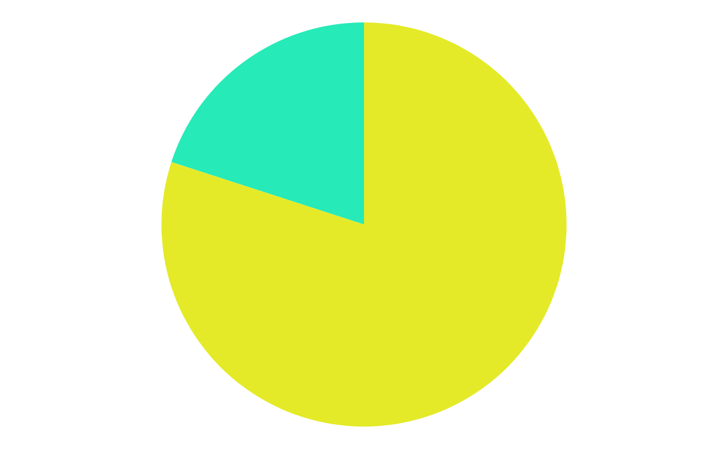
Data Selection
80%
Vodafone: Chosen Randomly
Axis Bank & Asian Paints: They had very fluctuating data since last 7-8 years
Training Dataset
Year: Jan-2015-2019
20%
Test Dataset
Year: Jan-2019-Jan-2020
Time-Period:
Selected data of 5 years
January 2015 - January 2020
Features:
date,open price, high price, low price, close price, adj close price, volume
Y. (n.d.). Yahoo Finance - Stock Market Live, quotes, Business & Finance News. Retrieved April 24, 2022, from https://finance.yahoo.com/

Slide 6
The Existing body of work
Currently, Long-Short Term Memory (LSTM) Model is used which is an artificial recurrent neural network architecture used in Deep Learning.
It is out of our scope of learning.
Most basic model available is using Linear Regression and Support Vector Machine (SVM)
It seems to be inefficient as it is unable to predict the Prices for a given time frame.
Autoregressive Integrated Moving Average (ARIMA) is also a better alternative to LR and SVM
Exponential Moving Average works the better than the previous two.

Slide 7
Approaches
01
03
Moving Average
Exponential Moving average
Four
Approaches
04
02
The ARIMA Method
Linear Regression

Slide 8
Approach
Linear Regression
Moving Average
The most basic machine learning algorithm that can be implemented on this data is linear regression.
returns an equation that determines the relationship between the independent variables and the dependent variable.
Smoothing method
A calculation used to analyze data points by creating series of averages of different subsets of the full data

Slide 9
Approach
Exponentially Moving Average
ARIMA Method
The EMA is moving Average that places a greater weight and significance on the most recent data points
It reacts more significantly to recent price changes than a moving average
Regression analysis that helps in representing strength of a dependent variable
Applicable to the time series data for better understanding of the data
Hayes, A. (2022, February 08). Autoregressive Integrated moving average (ARIMA). Retrieved April 24, 2022, from Link
Chen, J. (2022, March 18). Exponential moving average (EMA) definition. Retrieved April 24, 2022, from link

Slide 10
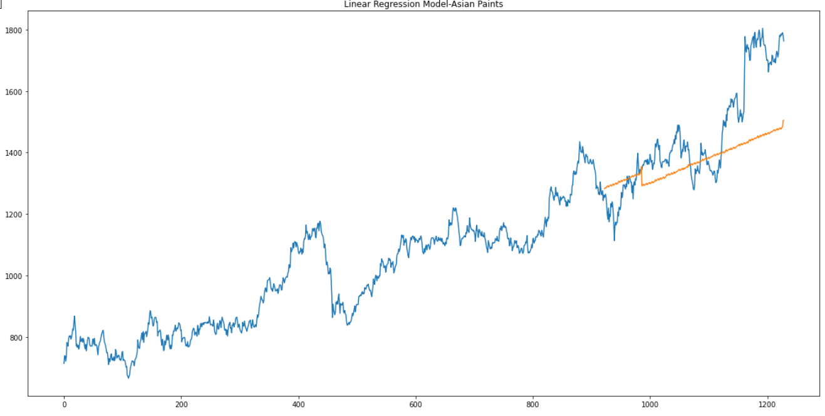
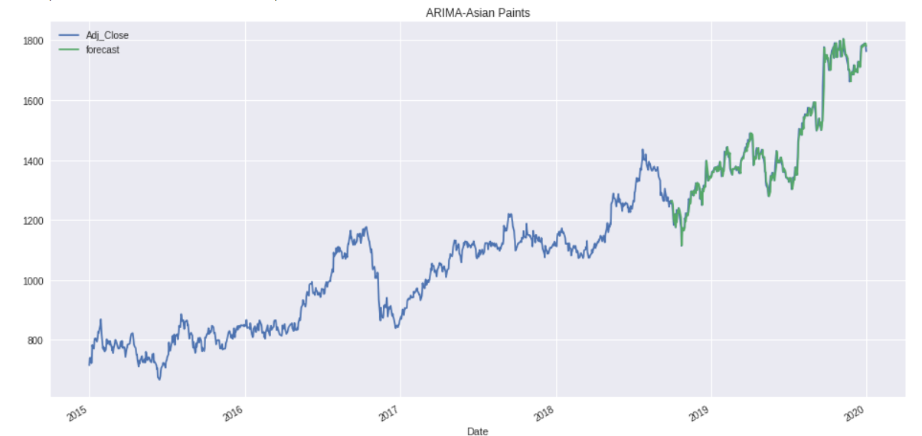
Results
Linear Regression Model
ARIMA Model (p,d,q)=(1,1,1)
Asian Paints
Asian Paints
RMSE Value =151.609
RMSE Value =22.0879

Slide 11
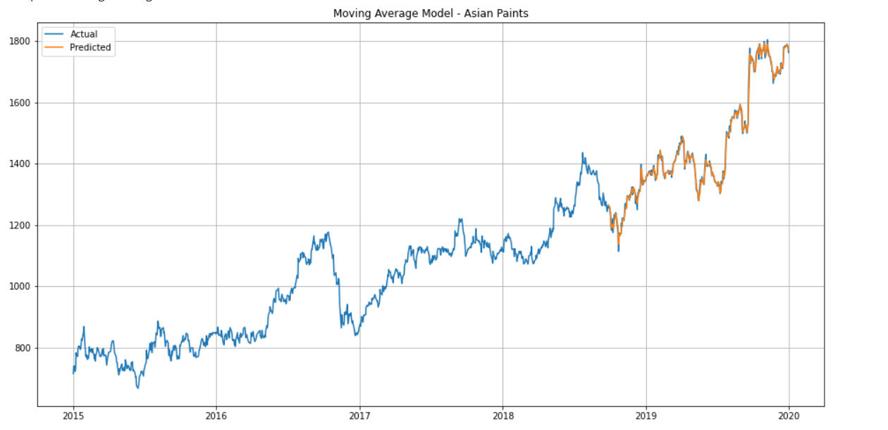
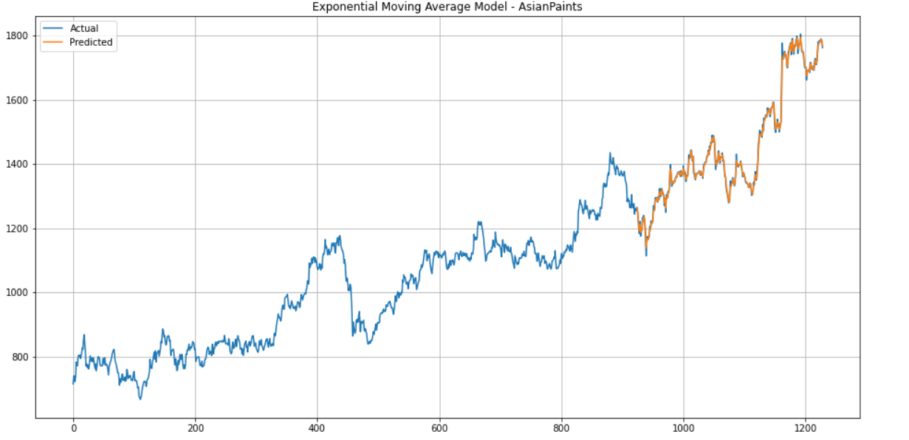
Results
Exponential Moving Average weight=2
Moving Average Model at period=2
Asian Paints
Asian Paints
RMSE Value = 11.0358
RMSE Value = 7.8764

Slide 12
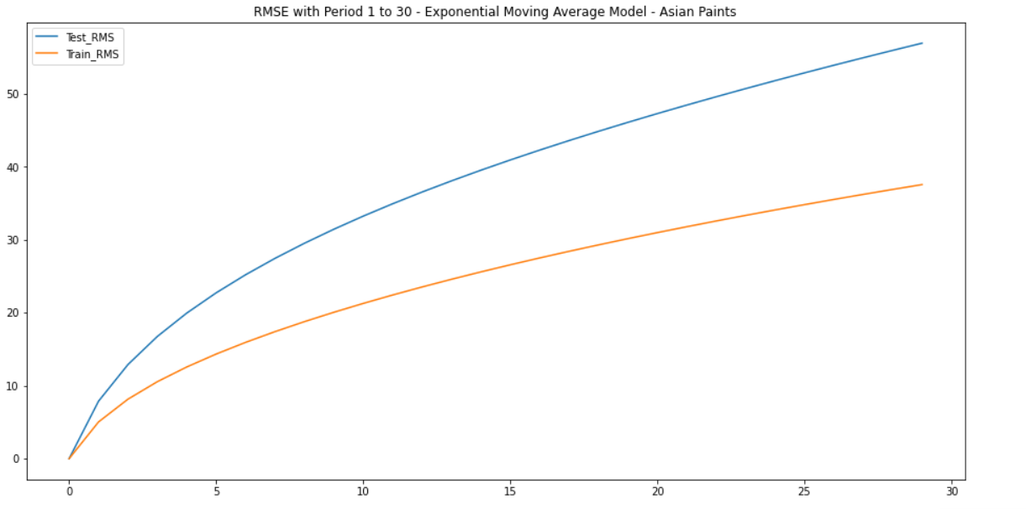
Why Weight=2?
Asian Paints
RMSE Value for weight=2 is minimum for test and train dataset.

Slide 13
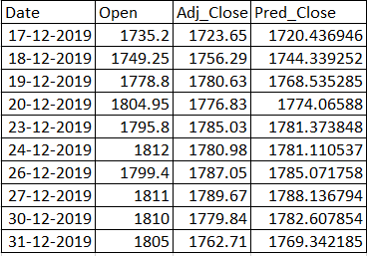
Exponential Moving Average Model for Asian Paints
Predicted closing price values for the test set adjusted close values

Slide 14
Conclusions
Linear regression approach: the model overfits to the date and month columns. The model will examine the value from the same day a month ago, or the same date/month a year ago, instead of the prior values from the point of prediction.
Simple moving average gives equal weights to all observations
Exponential MA gives more weight to most recent price data, which is considered to be more relevant than older data
RMSE values of Exponential Moving Average Model has least value compared to other models.
Exponential Moving Average approach best fits for required datasets.

Slide 15
Role of each group member
Sanskruti Shingala (AU1940124)
01
Research, Moving Average Model training and fitting, Data Handling, ARIMA model
Mansi Savaj (AU1940158)
02
Research, Linear Regression Model training and fitting, Report Writing, Presentation Preparation,Exponential Moving Average Model
Krinal Boghani (AU1940195)
03
Research, Moving Average Model training and selection, Data Handling,ARIMA model, Presentation Preparation
Udit Kapadia (AU1940214)
04
Research, Linear Regression model training, Exponential Moving Average Model,Report Writing

Slide 16
References
[1] Business, F. (n.d.). Retrieved April 24, 2022, from https://people.duke.edu/~rnau/411arim.htm
[2] Chen, J. (2022, March 18). Exponential moving average (EMA) definition. Retrieved April 24, 2022, from https://www.investopedia.com/terms/e/ema.asp#:~:text=An%20exponential%20moving%20average%20(EMA)%20is%20a%20type%20of%20moving,the%20exponentially%20weighted%20moving%20average.
[3] Harper, D. (2022, February 03). What drives the stock market? Retrieved April 24, 2022, from https://www.investopedia.com/articles/basics/04/100804.asp
[4] Hayes, A. (2022, February 08). Autoregressive Integrated moving average (ARIMA). Retrieved April 24, 2022, from https://www.investopedia.com/terms/a/autoregressive-integrated-moving-average-arima.asp#:~:text=ARIMA%20is%20a%20method%20for,points%20influence%20future%20data%20points.\
[5] Obthong, Tantisantiwong, Jeamwatthanachai, & Wills. (2020, May 06). A survey on machine learning for stock price prediction: Algorithms and techniques. Retrieved April 24, 2022, from https://eprints.soton.ac.uk/437785/
[6] West, Z. (2021, July 31). Calculating moving averages in Python. Retrieved April 24, 2022, from https://www.alpharithms.com/calculating-moving-averages-in-python-585117/
[7] Y. (n.d.). Yahoo Finance - Stock Market Live, quotes, Business & Finance News. Retrieved April 24, 2022, from https://finance.yahoo.com/

